Slide 1

General Social Survey
NAME: SHIVA KARTHIK PINJARLE MANMOHAN
UCID: SP3254
SUBJECT: MATH661

Slide 2
ABOUT THE DATASET
Description
The General Social Survey is a survey that gathers data on American society and opinions since 1972. This data set is a sample of 500 entries from the GSS, spanning 1973-2018, including demographic markers and some economic variables.
This data consists of 500 entities and some features:
Year: year respondent was surveyed
Age: age at the time of the survey, truncated at 89
Sex: respondent’s sex (self-identified)
College: whether or not the respondent has a college degree, including junior/community college
No. of persons: number of persons in the household
Hours: number of hours worked in the week before the survey truncated at 89
Income: total family income
Class: subjective socioeconomic class identification
Opinion: opinion of family income

Slide 3
This R code analyzes two examples using the `infer` package for statistical inference. Let's break down each part of the code.
Example 1: Testing Average Hours Worked per week
Null Hypothesis H_0: The average hours worked per week mu is 40.
Alternative HypothesisH_1 The average number of hours worked per week mu is not equal to 40.
Theory-Based Approach:
Calculate the t-statistic and p-value using the theoretical approach.
Simulation-Based Approach:
Use the `infer` package to perform a simulation-based approach.
Generate bootstrap samples under the null hypothesis H_0 and calculate the p-value.

Slide 4
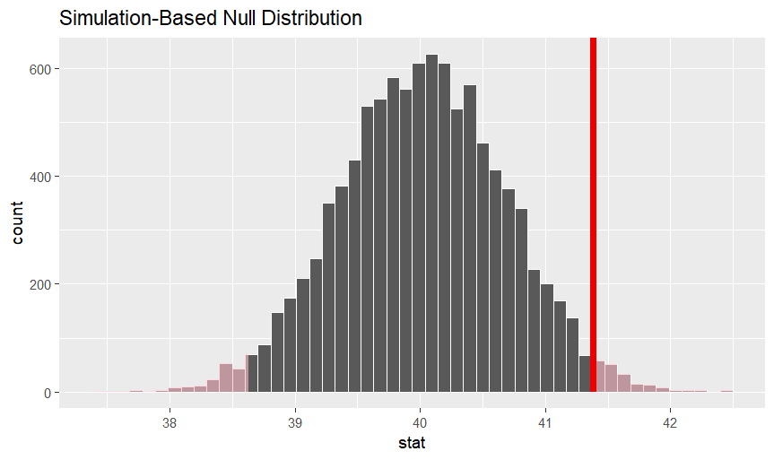
Conclusion
With a t-value is 2.0851 and p-value of 0.03755 we conclude that
Decision: Since the p-value is less than the chosen significance level (e.g., 0.05), there is evidence to reject the null hypothesis.
Interpretation: The data provides sufficient evidence to conclude that the average number of hours worked per week is significantly different from 40.

Slide 5
Example 2: Testing Proportion of College Graduates
Null Hypothesis H_0: The proportion of college graduates p is at least 0.4.
Alternative Hypothesis H_1:The proportion of college graduates p is less than 0.4.
Theory-Based Approach:
Calculate the z-statistic and p-value using the theoretical approach.
Simulation-Based Approach:
Use the `infer` package to perform a simulation-based approach.
Generate simulated samples under the null hypothesis H_0 and calculate the p-value.

Slide 6
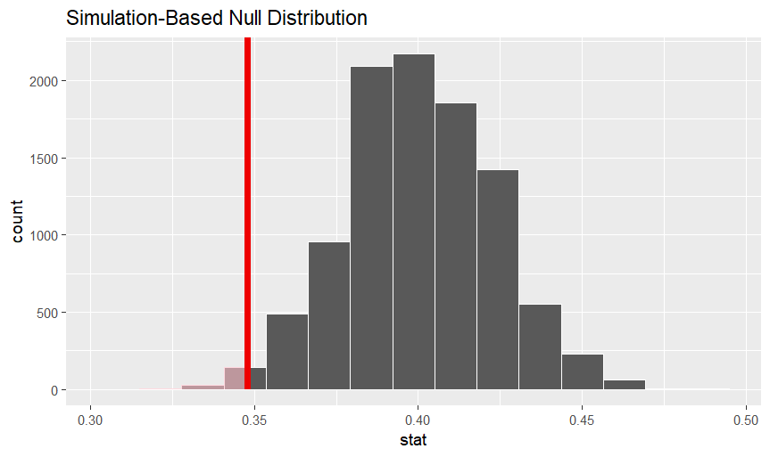
Conclusion
z= -2.373464 and pnorm=0.008811045
- Given a typical significance level (e.g., 0.05), the small p-value leads to the rejection of the null hypothesis H_0: p >=0.40.
- There is evidence to support the alternative hypothesis H_1: p < 0.40, indicating that the proportion of college graduates is statistically significantly less than 0.4.
Therefore, The proportion of college graduates p is less than 0.4

Slide 7
Thank you

